Slide 1


INSTITUTE: CHANDIGARH UNIVERSITY
DEPARTMENT: UIC
MCA
SOFTWARE TESTING
24CAH-654
DISCOVER . LEARN . EMPOWER

Slide 2

SOFTWARE TESTING
Unit -3
Test Management using JIRA

Slide 3
JQL (JIRA Query Language)
JQL is a domain-specific query language specifically designed for querying issues in JIRA. It allows users to construct queries to retrieve issues based on a wide range of criteria. Here are some key components of JQL:
Field Names:
JQL uses field names to represent specific attributes of issues (e.g., project, issuetype, summary, assignee). These fields can be used in queries to filter issues.
Operators:
Operators are used to compare values in JQL. Common operators include =, !=, <, >, <=, >=, IN, NOT IN, etc.
Logical Operators:
Logical operators (AND, OR, NOT) are used to combine multiple conditions in a query.
Functions:
JQL supports functions that allow users to perform calculations, aggregations, and other operations within queries. Examples include count(), average(), max(), min(), etc.

Slide 4
Examples of JQL Queries
Basic Query:
project = "Project Name" AND issuetype = Bug AND status = "In Progress"
Filter by Assignee:
assignee = username AND status = Open
Advanced Query with Logical Operators:
project = "Project Name" AND issuetype = Bug AND (status = "In Progress" OR status = "To Do")
Filter by Date:
created >= startOfDay() AND created <= endOfDay()

Slide 5
Different Types of issues in JIRA
In JIRA, issues represent tasks, items, or work items that need to be tracked and managed within a project. JIRA allows users to create different types of issues to suit various purposes and workflows. The default issue types in JIRA Software include:
Bug:
Represents a defect or error in the software that needs to be addressed and fixed.
Task:
Represents a single unit of work that needs to be accomplished, usually smaller in scope than a user story.

Slide 6
3. Story:
Represents a user requirement or feature from the perspective of an end user. Stories are commonly used in Agile methodologies.
4. Sub-task:
Represents a smaller piece of work that is part of a larger issue. Sub-tasks are used for breaking down complex tasks into manageable units.
5. Epic:
Represents a large body of work that can be broken down into smaller tasks or stories. Epics are often used to group related user stories.

Slide 7
6. Task (JIRA Core):
In JIRA Core, the term "Task" is used more generically to represent any work item, not specifically related to software development.
7. Sub-task (JIRA Core):
Similar to the Sub-task in JIRA Software, used for breaking down tasks into smaller units in JIRA Core.
8. Service Request (JIRA Service Management):
In JIRA Service Management, this issue type is used for managing service requests and incidents.

Slide 8
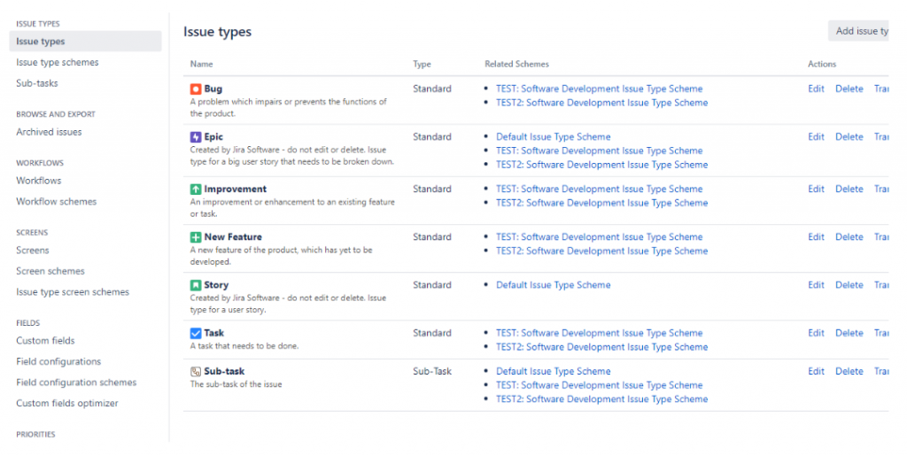

Slide 9
THANK YOU

